Slide 1
HEAP
By: Dr. Nina Javaher

Slide 2
Consider implementing a priority queue using an array
Sorted order
insert operation slow
removeMax operation fast
Arbitrary order
insert operation fast
removeMax operation slow
Note:
need a field to keep track of the number of values currently in the queue
need to decide how big to make the array initially
need to expand the array if it gets full

Slide 3
partial class definition
public class PriorityQueue {
// *** fields ***
private Comparable[] queue;
private int numItems;
private static final int INIT_SIZE = 10;
// *** constructor ***
public PriorityQueue() {
queue = new Comparable[INIT_SIZE];
numItems = 0;
}
...
}

Slide 4
Time Complexity
array sorted worst-case O(N) with N items in the queue
we can find the place for the new value efficiently using binary search, but then we'll need to move all the larger values over to the right to make room for the new value.
array sorted from low to high, the removeMax is O(1)
just decrement numItems and return the last value.
array unsorted-then insert is O(1) -- ignoring the time to expand the array but removeMax is O(N) since we must search the whole array for the largest value.
The empty operation is trivial -- just return true if numItems == 0, so it (and the constructor) are both O(1).

Slide 5
Using a Linked List
similar to using an array
we can keep the list sorted (which makes insert O(N)) or unsorted (which makes removeMax O(N)).
Note 1: if the list is sorted we must use linear search to find the place to insert the new value , but there is no need to move old values over. Also, unless we maintain a "tail" pointer, we should keep the list in order from high to low, since removing from the front of the list can be done in O(1) time.
Note 2: Note that for a linked list we don't need the numItems field; the empty operation returns true if the list is empty (which can be determined in O(1) time).

Slide 6
Using a BST
largest value can be found in time proportional to the height of the tree by going right until we reach a node with no right child
Removing that node is also O(tree height), as is inserting a new value
Balanced tree, Worse case O(log N)
Un-balanced tree, insert and removeMax can be O(N).
no need for a numItems field. (similar to linked list)

Slide 7
Heaps
a binary tree (in which each node contains a Comparable key value), with two special properties:
The ORDER property:
For every node n, the value in n is greater than or equal to the values in its children (and thus is also greater than or equal to all of the values in its subtrees).
The SHAPE property:
All leaves are either at depth d or d-1 (for some value d).
All of the leaves at depth d-1 are to the right of the leaves at depth d.
(a) There is at most 1 node with just 1 child. (b) That child is the left child of its parent, and (c) it is the rightmost leaf at depth d.

Slide 8
Practice Time

Slide 9
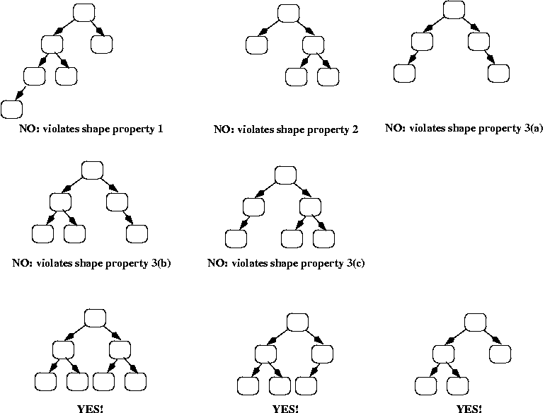
Example

Slide 10
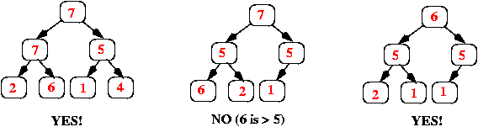
Example

Slide 11
Implementing priority queues using heaps
The standard approach: use an array (or an ArrayList), starting at position 1 (instead of 0), where each item in the array corresponds to one node in the heap:
The root of the heap is always in array[1].
Its left child is in array[2].
Its right child is in array[3].
In general, if a node is in array[k], then its left child is in array[k*2], and its right child is in array[k*2 + 1].
If a node is in array[k], then its parent is in array[k/2] (using integer division, so that if k is odd, then the result is truncated; e.g., 3/2 = 1).

Slide 12
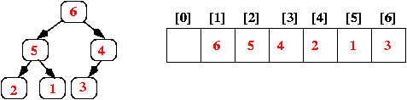
Example

Slide 13
Implementing Insert
The way to achieve these goals is as follows:
Add the new value at the end of the array; that corresponds to adding it as a new rightmost leaf in the tree (or, if the tree was a complete binary tree, i.e., all leaves were at the same depth d, then that corresponds to adding a new leaf at depth d+1).
Step 1 above ensures that the heap still has the shape property; however, it may not have the order property. We can check that by comparing the new value to the value in its parent. If the parent is smaller, we swap the values, and we continue this check-and-swap procedure up the tree until we find that the order property holds, or we get to the root.

Slide 14
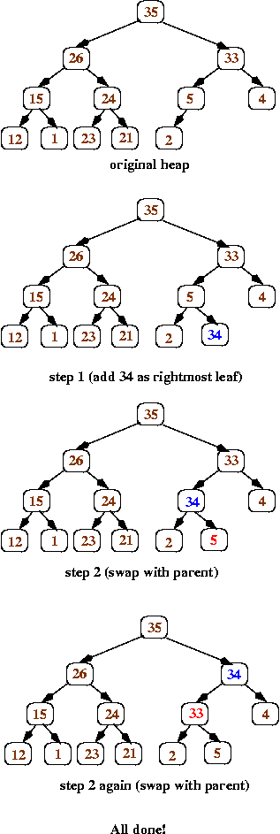
inserting the value 34 into a heap

Slide 15
Insert the values 6, 40, and 28 to the following BST

Slide 16
Practice Time

Slide 18
Implementing removeMax
Because heaps have the order property, the largest value is always at the root. Therefore, the removeMax operation will always remove and return the root value; the question then is how to replace the root node so that the heap still has the order and shape properties.

Slide 19
Implementing removeMax
Replace the value in the root with the value at the end of the array (which corresponds to the heap's rightmost leaf at depth d). Remove that leaf from the tree.
Now work your way down the tree, swapping values to restore the order property: each time, if the value in the current node is less than one of its children, then swap its value with the larger child (that ensures that the new root value is larger than both of its children).

Slide 20
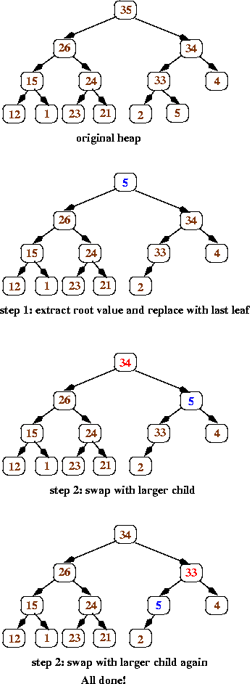
removeMax operation Example

Slide 21
Perform 3 more removeMax operations for the following

Slide 22
Practice Time

